Slide 1

Edulyt India Project Report
Satwik cheppla
Intern id-ei0063

Slide 2
Acknowledgement
With great pleasure, I would like to express my sincere gratitude and thanks to Edulyt India For giving me a wonderful opportunity of learning Data science in a more practical way that gives exposure to solving real-world problems. The Intern helped me to profoundly increase my interest in the field of data science and Machine Learning. I would also extend my gratitude to Training and Placement Cell of NIT Rourkela for effectively bridging the gap between Company and students.

Slide 3
Frame-work
Gathering and Understanding Data
Data preparation
Training
Evaluation
Parameter Tuning
Prediction

Slide 4
Gathering and understanding Data
The data is given by Edulyt India shared through a google drive
The data describes different parameters as features that will be considered for modelling a Machine learning Pipeline used for classifying the status of Customer Personal loan status as approved or not.
The following describes the features given in the data
Loanapp_ID : It gives the application ID Number of applicant
Sex : It describes the gender of applicant
Marital_Status : It categorizes if the applicant is married or unmarried

Slide 5
Gathering and understanding Data
first_name : First name of applicant
last_name : Last name of applicant
email : Email ID of applicant
address : Address of Applicant
Dependents :Number of persons dependent on the applicant
Qual_var : Qualification status, whether the applicant is graduated or not
SE : Whether Applicant is Self-Employed or Not
App_Income_1 :The Income of applicant 2

Slide 6
Gathering and understanding Data
App_Income_2 : Income of Applicant 2(Applicable if there are 2 applicants, generally done to increase the loan amount)
CPL_Amount : customer personal loan amount describes the total amount of loan taken by applicant
CPL_Term :The loan is repaid in regular payments over a set period of time, This period is term of loan
Credit_His :It is a categorical variable which explains if we know the credit history of customer.
Prop_Area : It is a categorical variable which divides if the customer is living in urban/rural/semi urban

Slide 7
Data Preparation
Sex 13
The data Is given in a excel format.(.xls).
All the operations of data preparation are done using pandas library in python taking jupyter notebook environment from Anaconda distribution.
There are two data files given namely Training and testing.
Initially training data is taken and studied and following observations are made
The training data set contains 614 rows and 20 columns
These are the null values for each feature

Slide 8
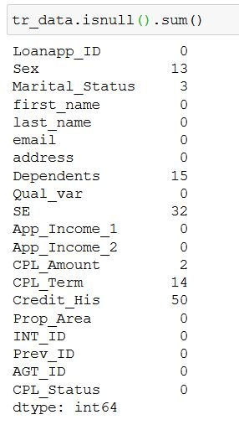
Data Preparation
We have approval percentage and declined percentage of 68.1 and 31.2 respectively.
As we can see these are null values and we have to work on them for efficient application of machine learning algorithms
Before that unnecessary features like ['Loanapp_ID','first_name','last_name','email','address', 'INT_ID','Prev_ID','AGT_ID’ ] are removed as they don’t add any value for classification
The dataframe is converted into array for applying methods for removing null values.

Slide 9
Data Preparation : dealing with null values
We would be using simple imputer taken from scikit-learn for categorical data which operates on the background of taking mode values
We would be using KNN imputer taken from scikit-learn library for numerical data which operates by taking k nearest neighbours as a function
So now there are no null values in the data.
The following are the Independent variables to be used in classification
Checking columns = ['Sex', 'Marital_Status', 'Qual_var', 'SE', 'Prop_Area','Dependents','App_Income_1','App_Income_2','CPL_Amount','CPL_Term','Credit_His']

Slide 10
Data Preparation
Out of these there are both categorical and continuous Independent variables
categorical variables = ['Sex', 'Marital_Status', 'Qual_var', 'SE', 'Prop_Area’]
Continuous variables = ['Dependents','App_Income_1','App_Income_2','CPL_Amount','CPL_Term’,'Credit_His’]
Dependent variable(for classification) = CPL_status
As these are categorical variables have strings as data, but whatever algorithm we apply(except few)would require us to convert into numerical forms

Slide 11
Data Preparation : encoding
So we would be using one hot encoding on categorical dependent and independent variables using pandas get dummies class.
Also we would be scaling the numerical data for uniformity using StandardScaler from sklearn library applied through column transformer.
After The transformations we get the final dataset which can be used to send through machine learning pipelines

Slide 12
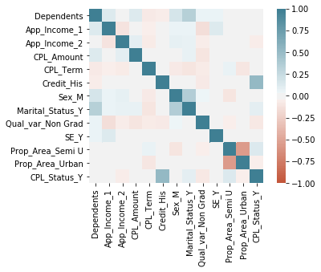
Data Preparation : Correlation
We have to find correlation between different features with dependent feature for better understanding of data .The correlation plot which is heat map is mapped using seaborn library. from the heatmap it can be observed that proper area and credit history has a significant correlation with the dependent variable.

Slide 13
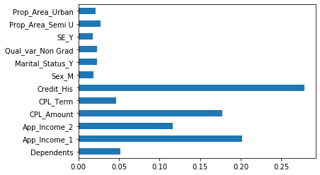
Data Preparation :Feature Importance
Feature importance is a important analysis which describes how important are the independent features and how much are they contributing to the classification of final dependent feature .Here we have used feature_importances_ property from RandomForestClassifier class using scikit learn library. Here we can observe that credit_His,CPL_Amount,App_Income_1 are important features for classification of CPL_status_Y.

Slide 14
Applying Machine Learning Algorithms
We have processed data and gained important insights from the data
We have to repeat the process for given test data set as well, But the catch is here we have to assign the dependent variable values to test data set after predicting the test values through algorithms
Now we have to Apply following Machine learning algorithms to the processed training data
Logistic Regression
Support Vector Classifier
K-nearest Neighbours

Slide 15
Applying Machine Learning Algorithms
Decision Tree classifier
Naive Bayes classifier
Random Forest Classifier
ADABoost classifier(Adaptive Boosting Algorithm)
XGBoost classifier(Extreme Gradient boosting algorithm)

Slide 16
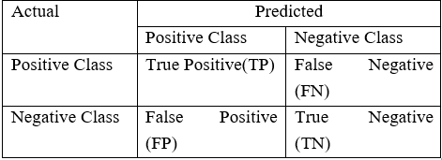
Evaluation of a classification algorithm performance is measured by the Confusion Matrix which contains information about the actual and the predicted class.

Slide 17
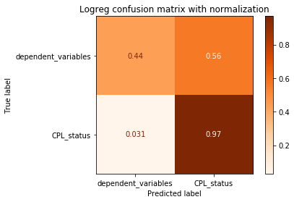
Logistic Regression
it is a predictive analysis algorithm and based on the concept of probability.
Here we would be using Binary Logistic Regression Model in which target or dependent variable have two possible types 1 or 0
We use LogisticRegression class from sklearn
On applying to the Training data set for classification of CPL_status by logistic regression we get score of 80.29% using accuracy_score function

Slide 18
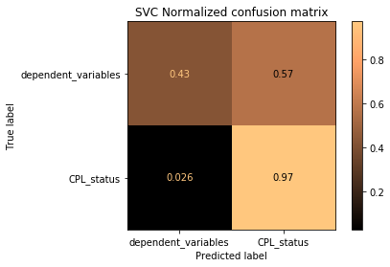
Support Vector Classifier
In the SVM algorithm, we plot each data item as a point in n-dimensional space (where n is number of features you have) with the value of each feature being the value of a particular coordinate
We use LinearSVC class from sklearn library.
On applying to the Training data set for classification of CPL_status by SVC we get score of 80.29% using accuracy_score function

Slide 19
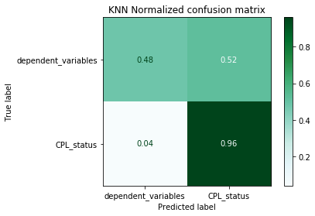
K-Nearest Neighbours
KNN works on principle that given an unclassified point, we can assign it to a group by observing what group its nearest neighbors belong to.
KNN uses ‘feature similarity’ to predict the values of new datapoints.
We use KNeighborsClassifier class from sklearn library .
We selected the value of n_neighbours by plotting error vs different n_neighbour values .
On applying to the Training data set for classification of CPL_status by KNN we get score of 80.94% using accuracy_score function

Slide 20
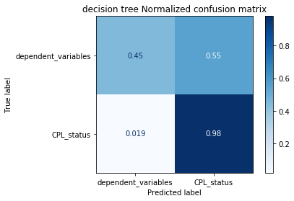
Decision Tree
In Decision Trees, for predicting a class label for a record we start from the root of the tree. We compare the values of the root attribute with the record’s attribute. On the basis of comparison, we follow the branch corresponding to that value and jump to the next node.
We use DecisionTreeClassifier from sklearn.tree
On applying to the Training data set for classification of CPL_status with Decision tree we get score of 81.43% using accuracy_score function

Slide 21
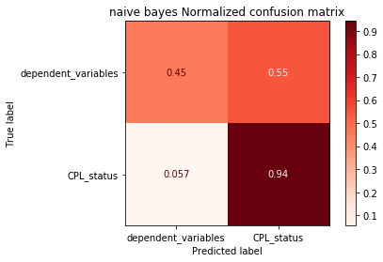
Naive Bayes classifier
A Naive Bayes classifier is a probabilistic machine learning model that’s used for classification task. The crux of the classifier is based on the Bayes theorem.
It assumes that features are independent to each other
We use GaussianNB class from sklearn.naive_bayes for classification
On applying to the Training data set for classification of CPL_status with Naïve-Bayes we get score of 78.99% using accuracy_score function

Slide 22
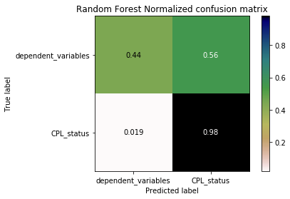
Random Forest classifier
As an alternative to limiting the depth of the tree, which reduces variance (good) and increases bias (bad), we can combine many decision trees into a single ensemble model known as the random forest.
The random forest combines hundreds or thousands of decision trees, trains each one on a slightly different set of the observations, splitting nodes in each tree considering a limited number of the features. These generally trade higher bias for lower variance.
We use RandomForestClassifier from sklearn.ensemble
Using RandomForest on Training, set we get an accuracy of 81.27%

Slide 23
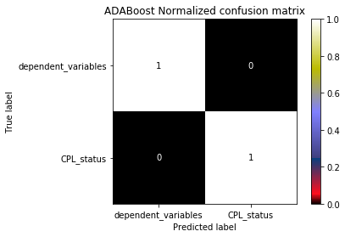
ADABoost classifier
One way for a new predictor to correct its predecessor is to pay bit more attention to training instances the predecessor underfitted. AdaBoost uses this method.
It weighs data points hard to predict
Scikit-Learn uses a multiclass version of AdaBoost(Stage wise Additive Modelling using Multi class Exponential loss function)
As we can see model is overfitting the training data.
Using ADABoost on Training, set we get an accuracy of 100%

Slide 24
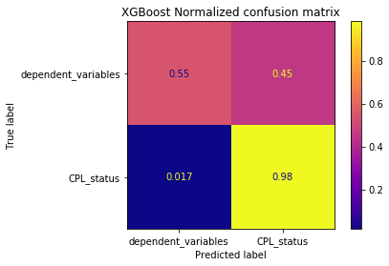
XGBoost(Extreme gradient boosting)
Boosting is an ensemble technique where new models are added to correct the errors made by existing models. Models are added sequentially until no further improvements can be made.
Gradient Boosting tries to fit new predictor to residual errors made by previous predictor. It uses gradient descent to avoid losses when adding new algorithms
XGBoost is a fastest of all gradient boosting algorithms, it is a parallel tree boosting algorithm
we used XGBClassifier class from xgboost library
Using XGBoost we achieved an accuracy of 84.69%

Slide 25


